Slide 1
BLJ91A Website
02-09-2024

Slide 2
“Welcome” Page
Some general “Hi, and welcome to BLJ91A Ltd” stuff

Slide 3
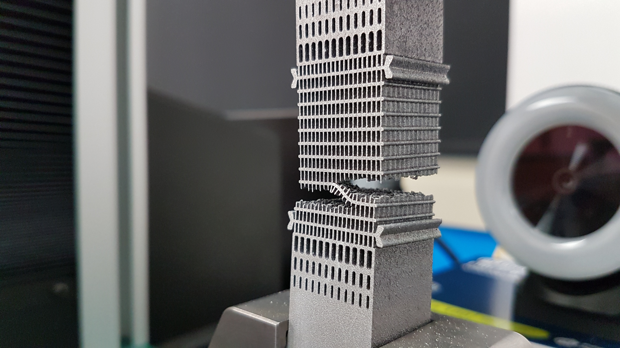
Manufacturing Plant Process Development
The BLJ91A team has years of experience in establishing manufacturing processes including:
additive manufacturing process routings
materials coupon testing processes

Slide 4
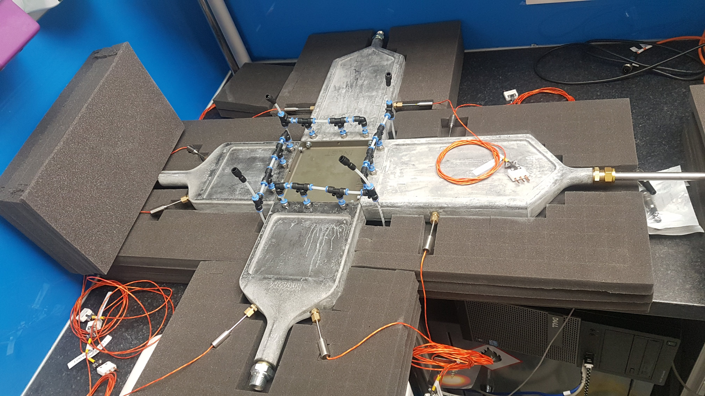
Calorific Heat Transfer Testing
Motorsport and aerospace heat exchanger calorific performance testing
Test rig design and equipment specifications
Component selection
Flow meters
Pressure transducers
Temperature sensors
Air heaters
Water preparations systems (flow rates and temepratures)
CAD design of interface devices
Data capture software and hardware architecture

Slide 5
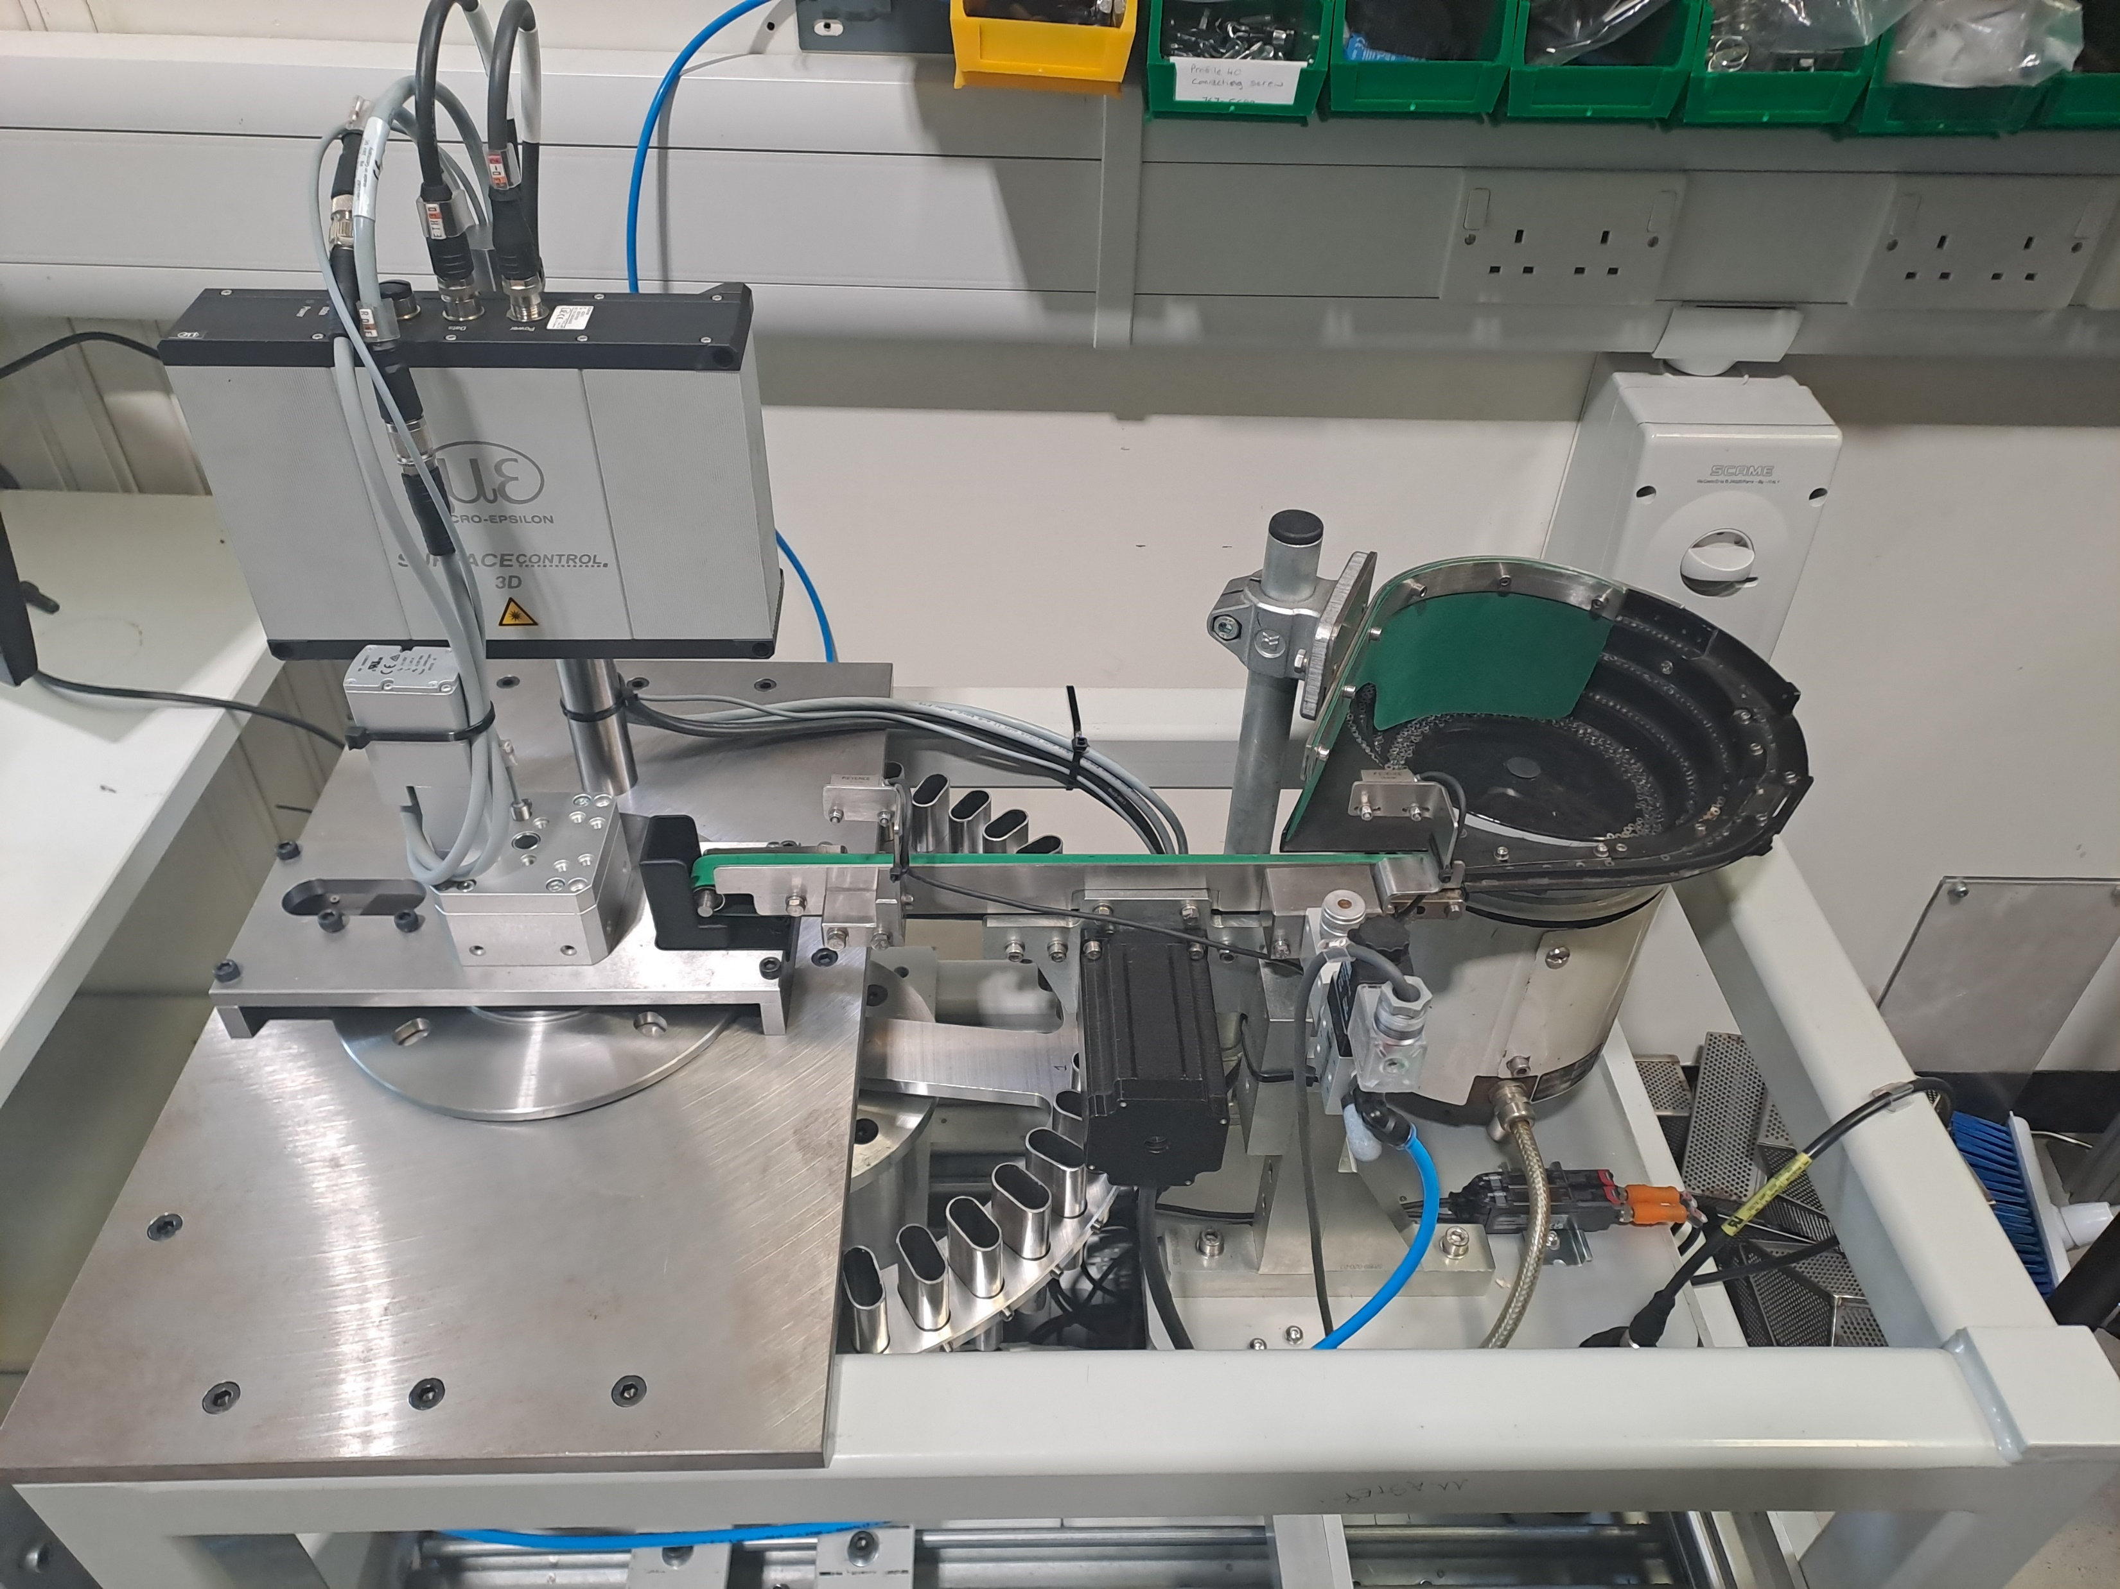
Mechanical Automation Shim Sorting Machine
The BLJ91A team worked in a collaborative partnership to develop an automated component sorting machine. The project included:
the selection of industrialised structured light measurement equipment to measure component thickness with a 1µm accuracy.
the specification and electrical design of the automation equipment
working with third party specialists in bowl-feeder technology
integrating all automation equipment with Siemens PLC control

Slide 6
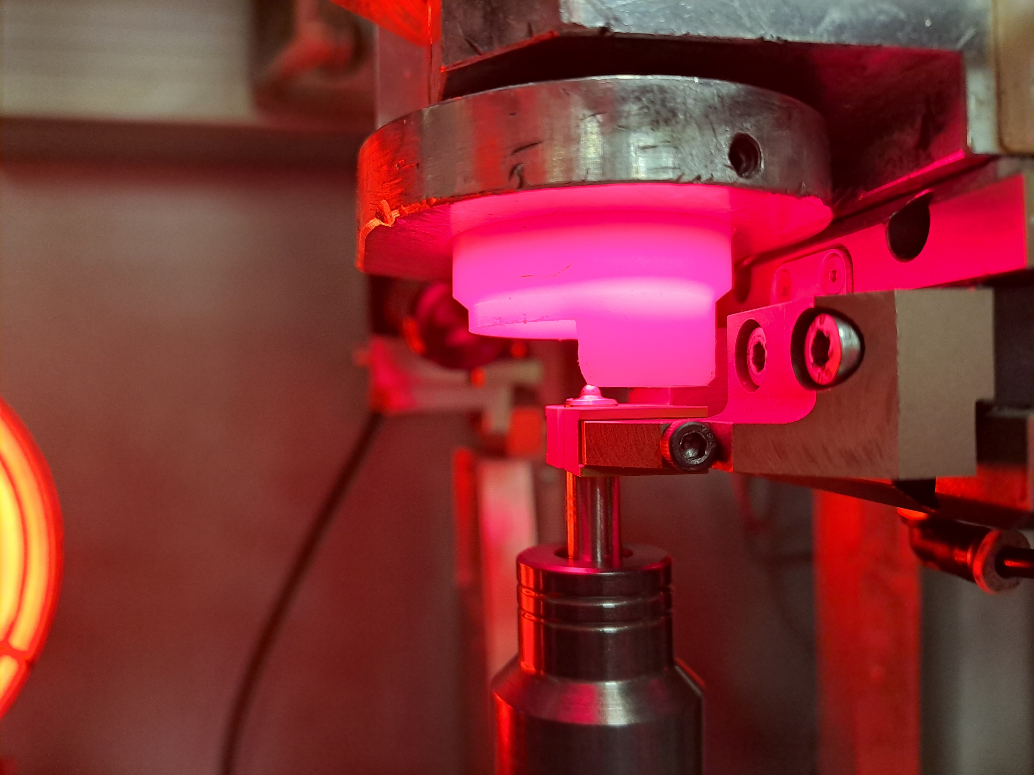
Automative Assembly Line
While working with existing automated manufacturing equipment, ongoing support and upgrades were implemented for the continual improvement of up-time, production through-put and first-time-pass-rate

Slide 7
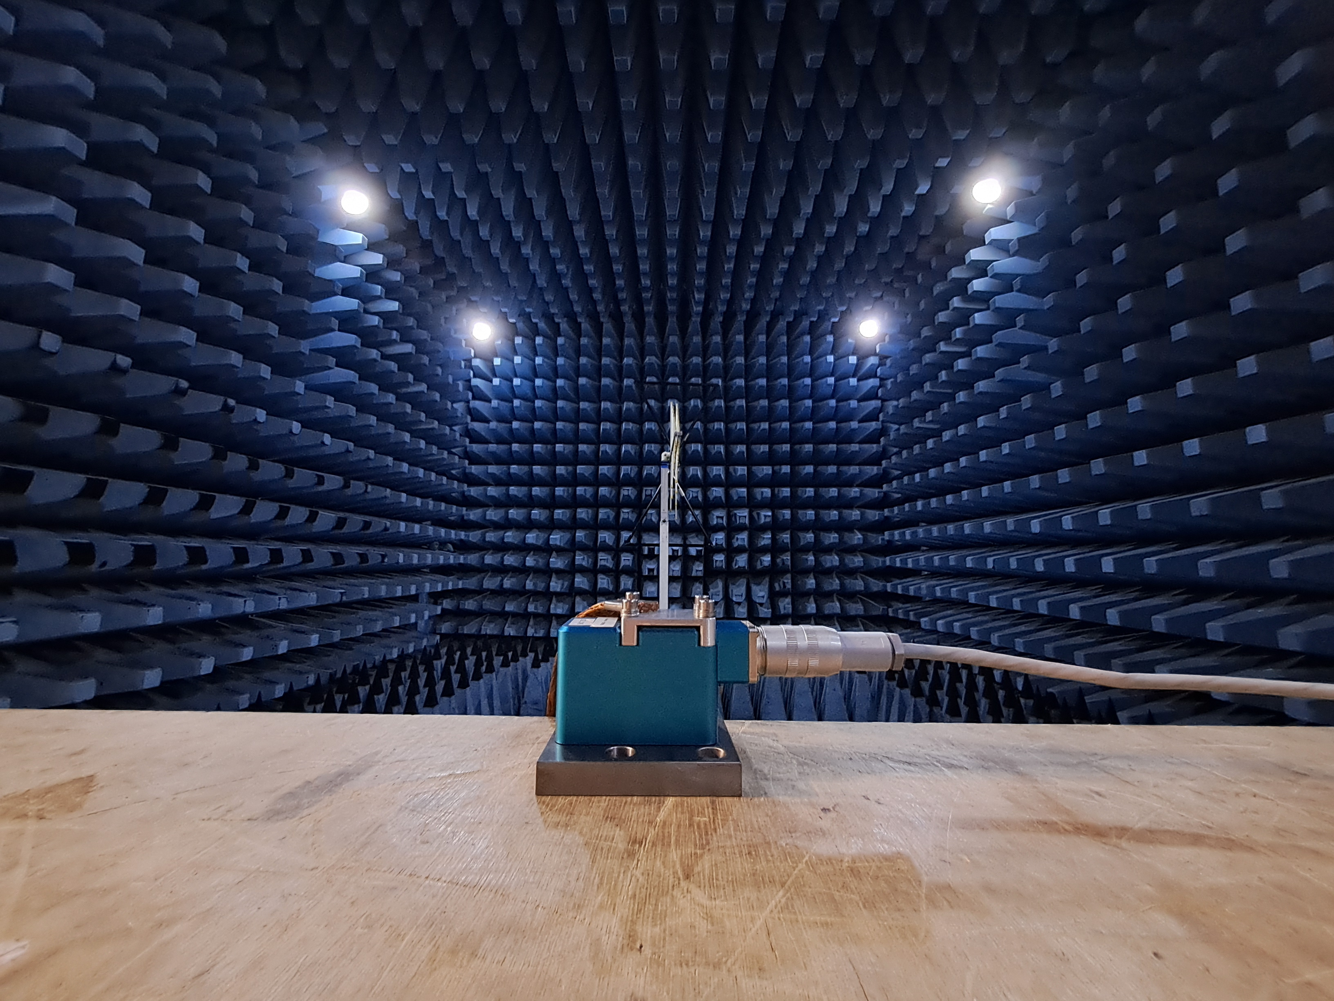
Lloyd’s Register Marine Certification Testing
xzvzxcv

Slide 8
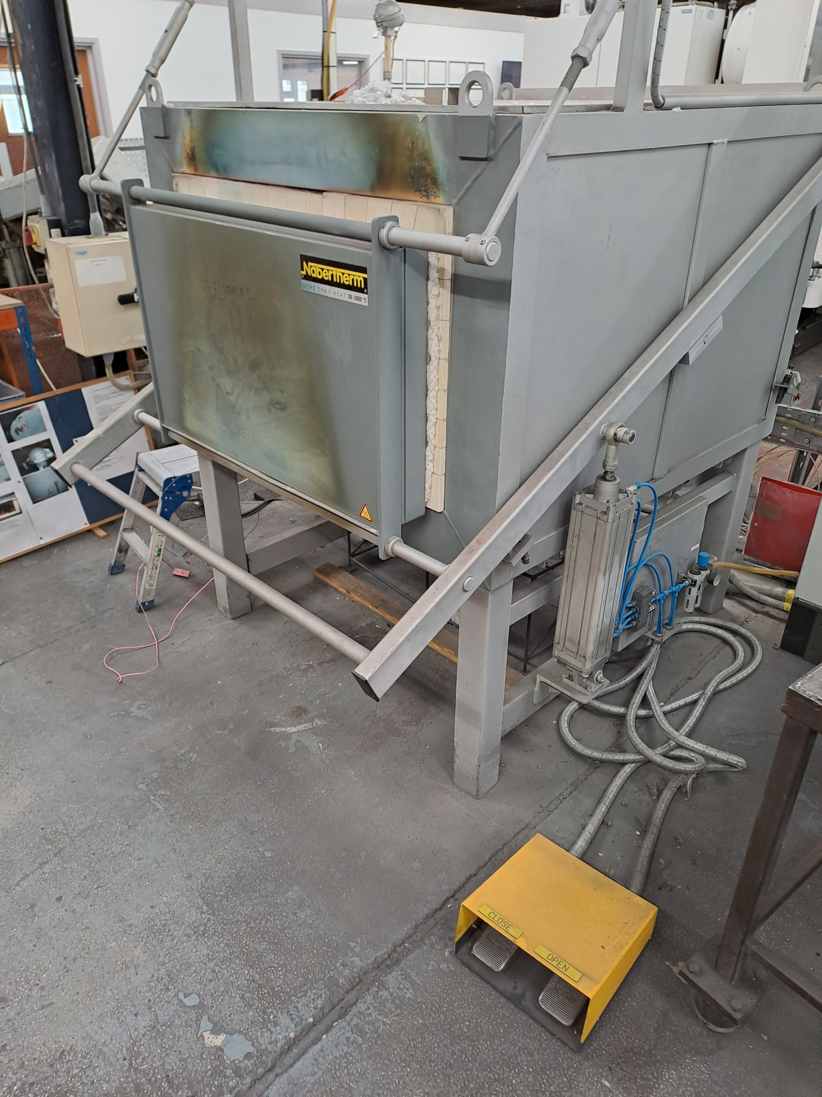
NADCAP/AMS2750 Heat Treatment Process Development
safsd

Slide 9
Sponsorship – Pink Triangle Racing

Slide 10
Sponsorship – Pink Triangle Mountaineering

